Slide 1


Individuals CES
Complete Program Overview

Slide 2
Content Overview
PART 1: ICES Access Point Roles and Responsibilities
PART 2: ICES Workflow
PART 3: Data Corrections
PART 4: Sample Scenario
FAQs & Resources Slide Available

Slide 3
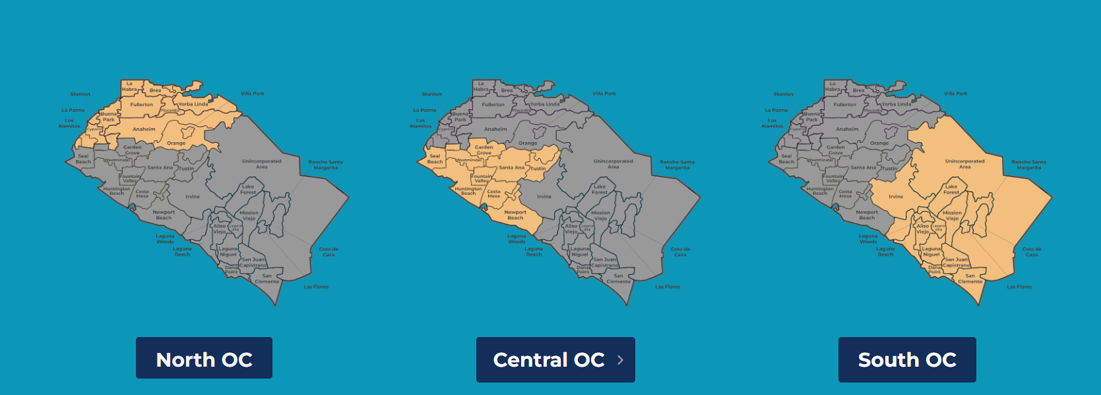
Service Planning Area (SPA)

Slide 4
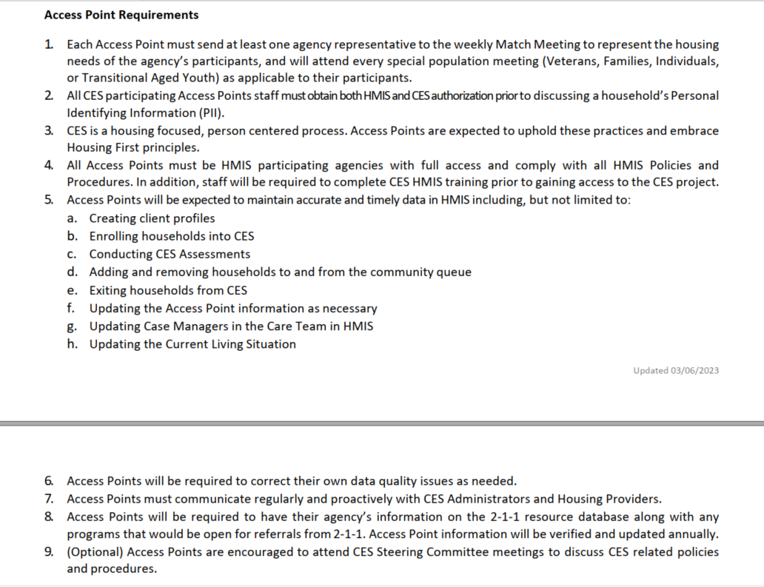
CES Access Point Agency Agreement
All CES Access Point Agencies are required to sign the Agency agreement to participate in ICES.
Part 1: Access Point Roles & Responsibilities

Slide 5
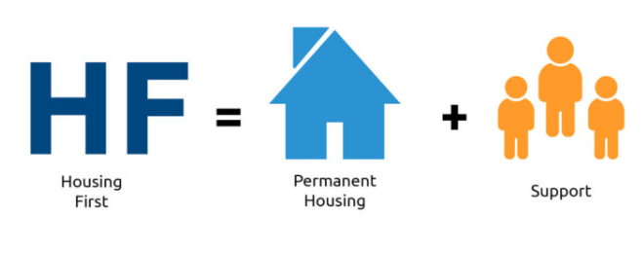
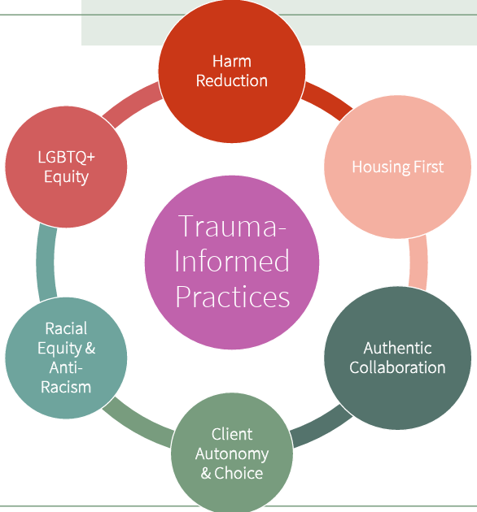
Orange County CES Best Practices
All Agencies participating in HMIS are expected to adhere to best practices.
Housing First: Orange County CoC embraces Housing First by offering housing and services without preconditions (e.g., sobriety, mental health treatment, or minimum income). Rapid placement and stabilization in permanent housing are primary goals.
Part 1: Access Point Roles & Responsibilities
Trauma-Informed Care: Recognizing the impact of trauma and responding to it with care and sensitivity.
Harm-Reduction: Providing stable housing and support services while minimizing the negative effects of risky behaviors (e.g., substance use) without requiring abstinence.

Slide 6
Knowledge Check
CES Access Point staff should understand the following:
HUD definitions of Literal Homelessness, Chronic Homelessness, and Disability.
HUD definition for a break in homelessness, including defining institutional stays.
Who has been identified as the agency's HMIS Administrative contact.
Part 1: Access Point Roles & Responsibilities
By the end of this training, attendees should know:
How to correctly complete the ICES enrollment screen fields.
Which documents are required and/or recommended for CES participation.
How to correctly complete third-party homeless verification, including when to attach agency letters.
ICES Community Queue (CQ) prioritization and how to refer to the ICES CQ.
Where to locate the referral to the CQ and referral notes.
How to fix enrollment screen and/or documentation errors.
How to access and review the weekly prioritized list emails and attend ICES Virtual Office Hours.
How to access and attend the CES Match Meetings and know which SPA meetings to attend.
Post-match meeting steps after verbally accepting a match.

Slide 7
Part 2: ICES WORKFLOW
ICES Program Enrollment
Homelessness Documentation
Housing Planning
Assessment & Referral
Match Meetings
Match Confirmation and Housing Navigation
ICES Data Standards for Participation

Slide 8

Ices workflow:
ICES Program enrollment
ICES Program Enrollment
Homelessness Documentation
Housing Planning
Assessment & Referral
Match Meetings
Match Confirmation and Housing Navigation
ICES Data Standards for Participation
KNOWLEDGE BASED ARTICLE
Click on the link to view step-by-step instructions.

Slide 9
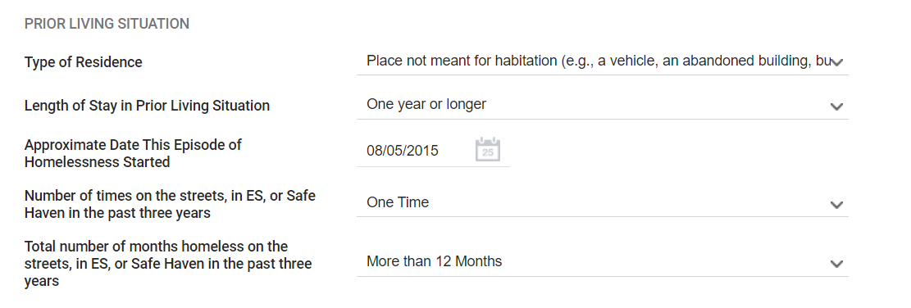
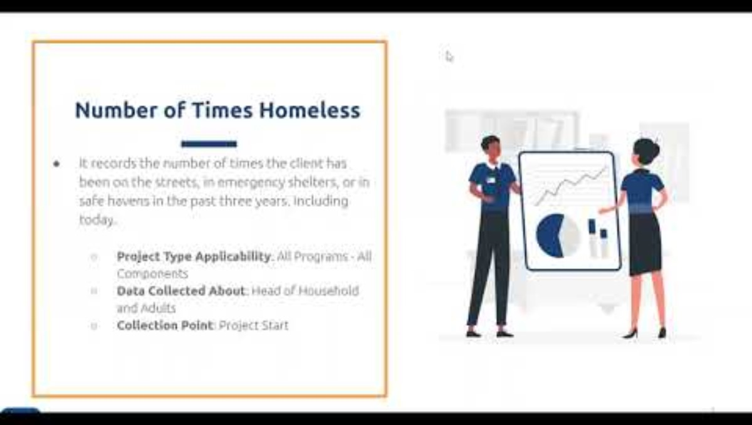
ICES Program Enrollment:
Enrollment Fields for Community Queue (CQ)
(3) Fields for CQ Prioritization:
Type of Residence =
Where did they sleep last night?
2. Approximate Date This Episode of Homelessness Started =
Report the start date of the CURRENT EPISODE of Homelessness.
3. Number of times on the streets, in ES, Safe Haven in the past three years =
Number of unique homeless episodes
(not shelter stays).

Slide 10
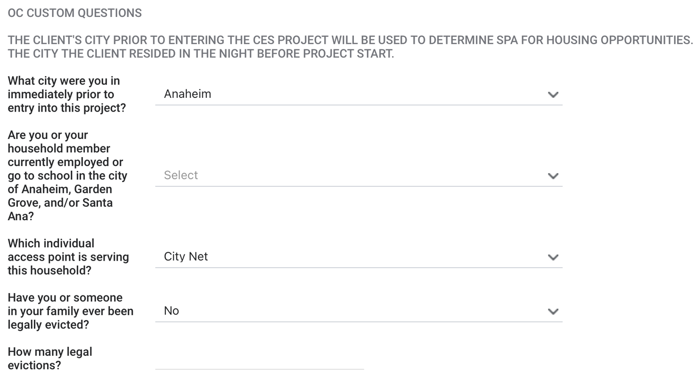
ICES Program Enrollment:
Enrollment Fields that determine SPA and city ties
OC Custom Questions:
The city prior to enrollment in the CES project determines which SPA the participant is referred to =
What city did they sleep in on the night before enrollment?
2. School and Employment City Ties for Anaheim, Garden Grove, and/or Santa Ana =
Report ties to these cities through school or work to be considered for opportunities.
If a participant is new to your caseload, update the enrollment to reflect which access point is serving the household and the assigned staff member.

Slide 11
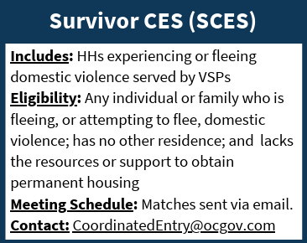
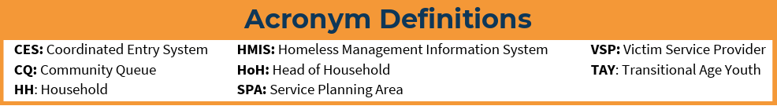
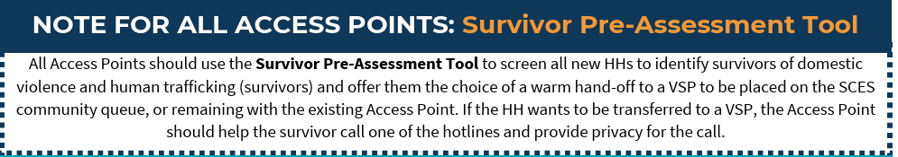
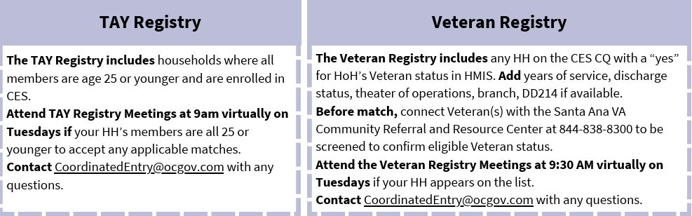
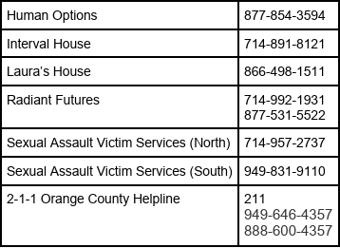
Survivor CES (SCES), Transitional Aged Youth (TAY) Registry, and Veteran Registry
VSPs in Orange County:

Slide 12
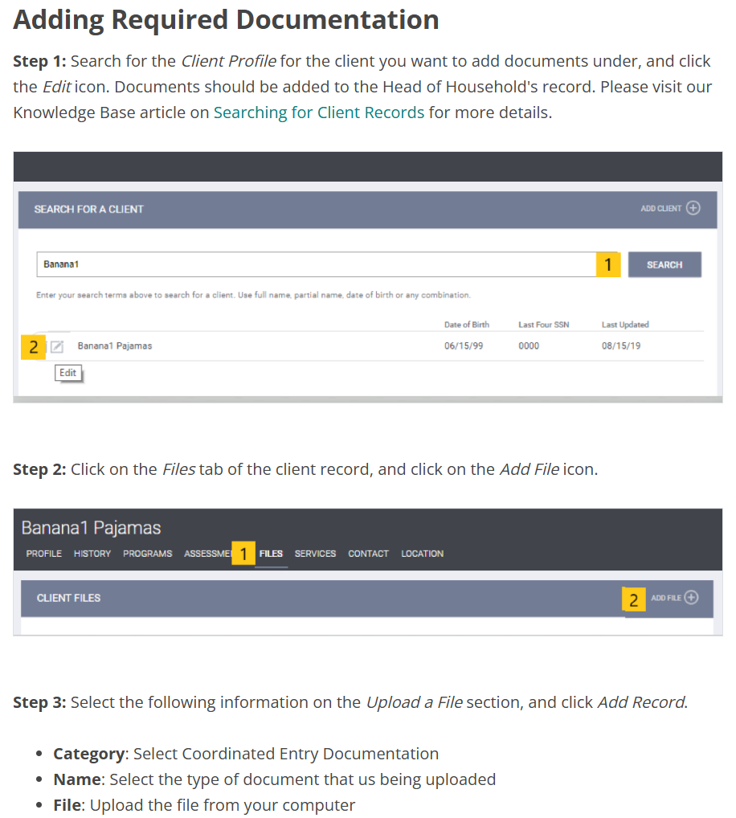
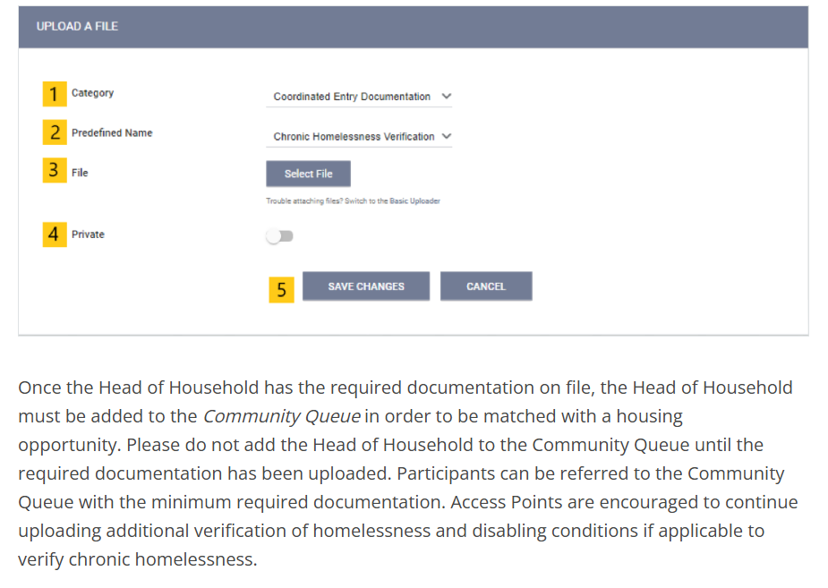
Ices workflow:
Adding homelessness documentation
ICES Program Entry
Homelessness Documentation
Housing Planning
Assessment & Referral
CQ Referral
CQ Prioritization
Match Confirmation and Housing Navigation
ICES Data Standards for Participation

Slide 13
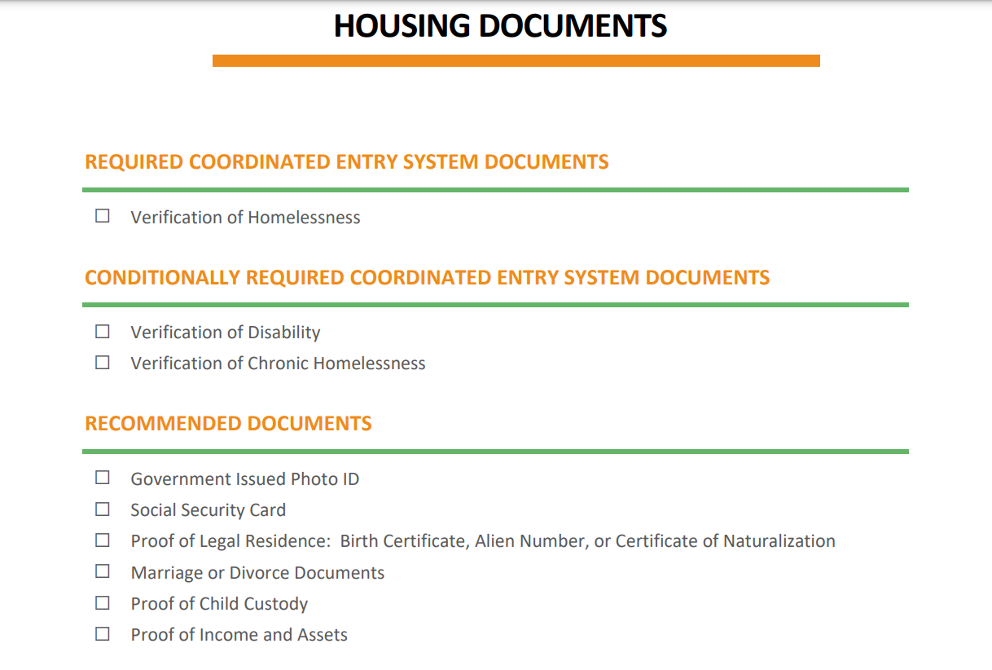
ADDING HOMELESSNESS DOCUMENTATION
CES HOUSING DOCUMENTATION
Required for CES participation
Required when a participant:
  Reports any disability
  Meets HUD's definition for Chronic Homelessness: https://www.hudexchange.info/homelessness-assistance/coc-esg-virtual-binders/coc-esg-homeless-eligibility/definition-of-chronic-homelessness/
Required by Housing Providers upon receiving a housing referral.

Slide 14
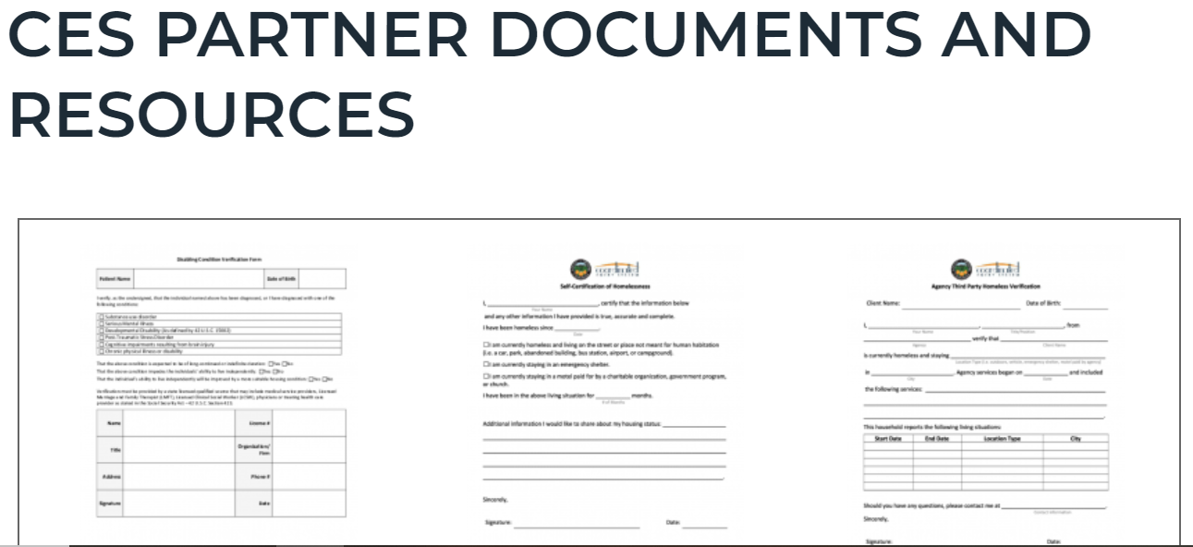

ADDING HOMELESSNESS DOCUMENTATION:
WHERE TO LOCATE CES FORMS
Agency Homeless Verification, Third-Party
Homeless Verification, Self-Certification
At-Risk of Homelessness Verification
Universal PHA Disability Verification
PHA FAQS
CES Partner Documents can be found at OCgov.com
For a current list of CES documents, please click here.

Slide 15
ADDING HOMELESSNESS DOCUMENTATION:
REQUIRED INFORMATION
​All verifications, regardless of source, must answer:
When = What months or how frequently did they encounter the participant?​
Where = Where did the encounters take place?​
What = What services were provided to the participant?​
How = How does the verifier know the participant is experiencing literal homelessness? ​

Slide 16
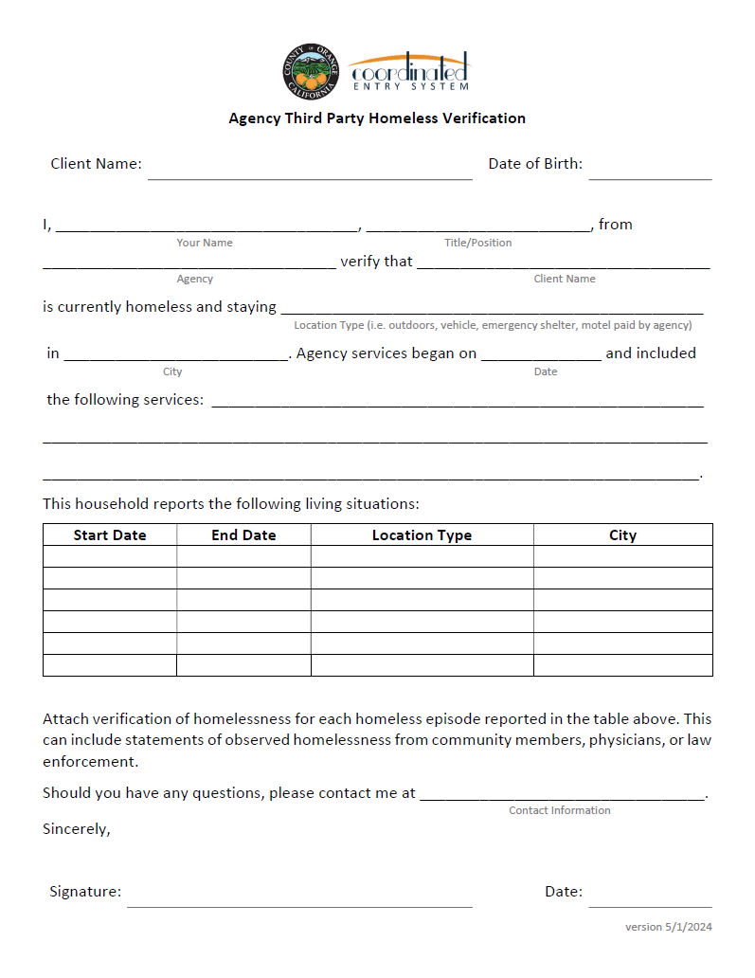
ADDING HOMELESSNESS DOCUMENTATION:
AGENCY THIRD PARTY FORM
"Agency services began on..."
Date any services began to end date or "current."
"and included the following services..."
List services provided and how verifier knew the participant was homeless at the time of the encounters.
"This household reports the following...:
List each self-reported living situation (street, motel, couch, shelter etc.) since their homelessness began.

Slide 17
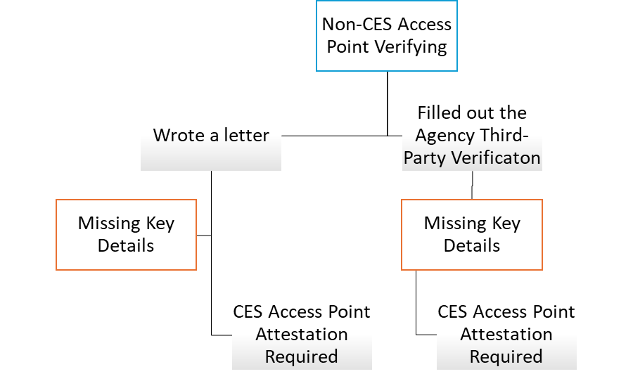
NON-CES SOURCES OF VERIFICATION
Decision Tree
Key Details:
When?
Where?
What?
How?

Slide 18

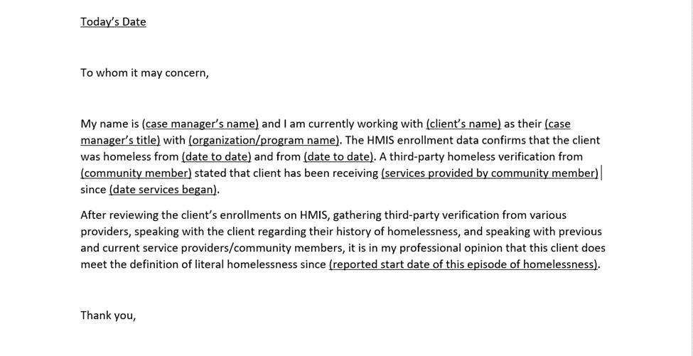

CES ACCESS POINT ATTESTATION LETTER
CES Access Points can download this template from the ICES Website here.

Slide 19
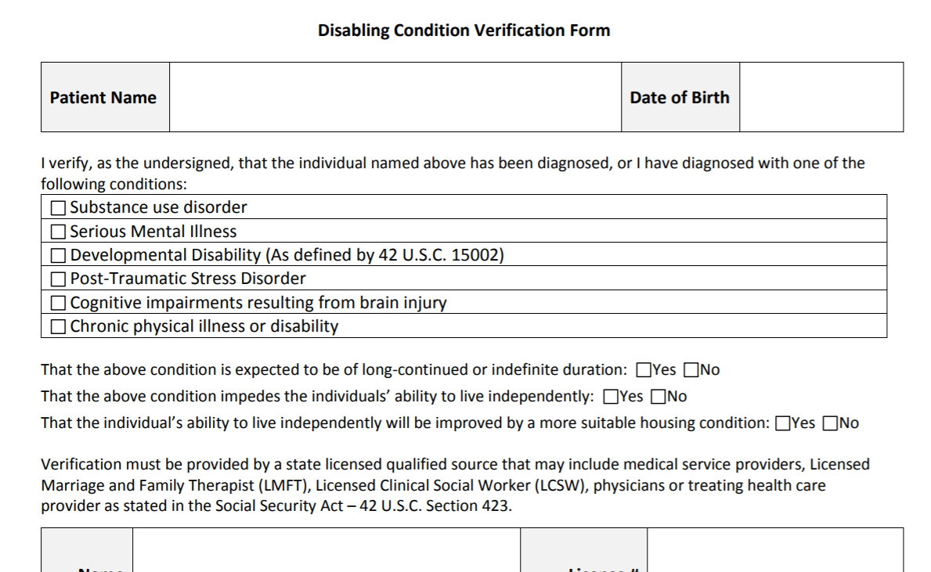

DISABILITY VERIFICATION
CES DOCUMENTATION LABELS
An acceptable Disabling Condition Verification must:
Tick at least one condition box.
All conditional Y/N statements ticked 'YES.'
Signed by a state licensed clinical provider.
NOTE: This document is time-bound:
Housing programs may want verifications dated within the past year.
HUD’s Disability Definition: https://www.hudexchange.info/homelessness-assistance/coc-esg-virtual-binders/coc-esg-homeless-eligibility/determining-and-documenting-disability/disability-definition/

Slide 20
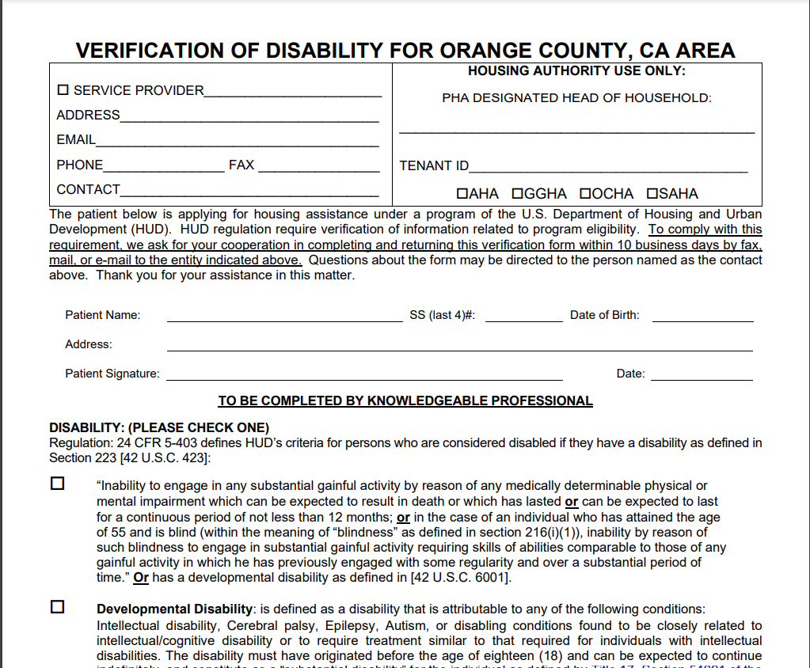
UNIVERSAL DISABLING CONDITION
Access Point Agency
Does not expire.
Accepted by all PHAs.
CES Access Points complete upper left 'Service Provider,' information.
Knowledgeable Professional is defined as a state licensed clinical professional.

Slide 21
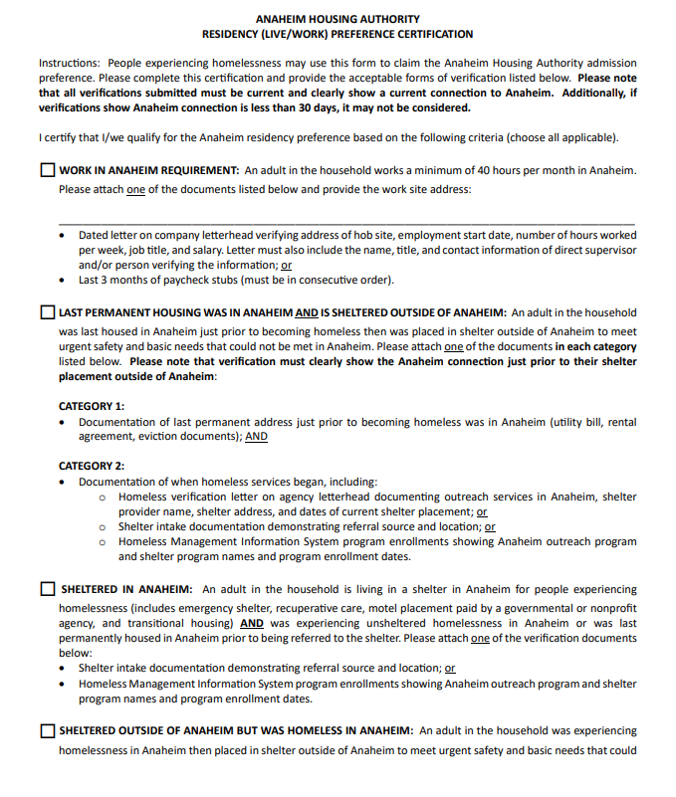
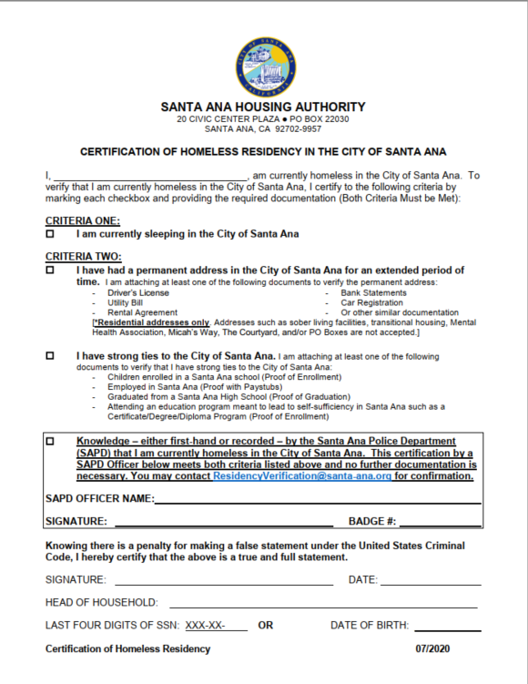
Recommended Forms and Documents
City Resident Documents
City residency documents are NOT required before a match to a project with a city preference.

Slide 22
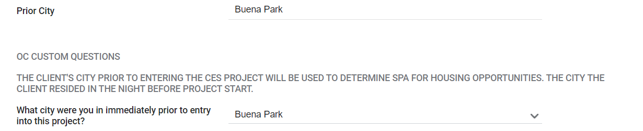
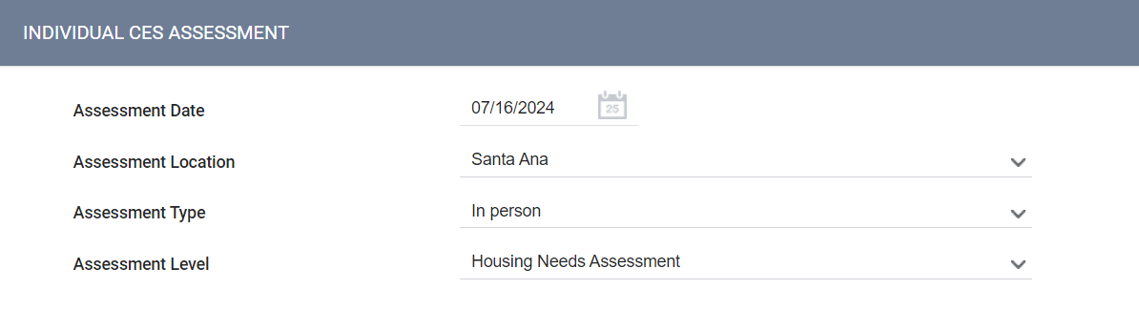
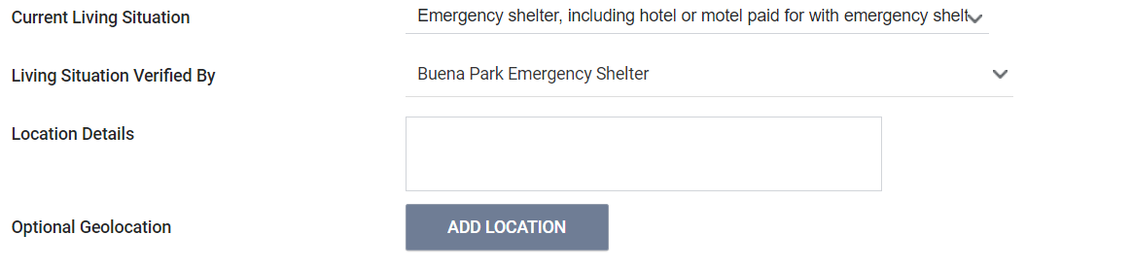
HMIS FIELDS: CITY TIES
ICES Enrollment Screen: prior city and city at entry:
To be included on a prioritized list for an Anaheim, Garden Grove or Santa Ana program:
Their prior city is one of the three cities.
They have identified school or employment ties for one of the three cities.
An assessment location was recorded as one of the three cities.
Individual CES Assessment Location
Current Living Situation Assessment Location
2024 Residency/City Ties Training: https://ceo.ocgov.com/page/ces-partner-documents-and-resources/2024-residency-city-ties-training

Slide 23
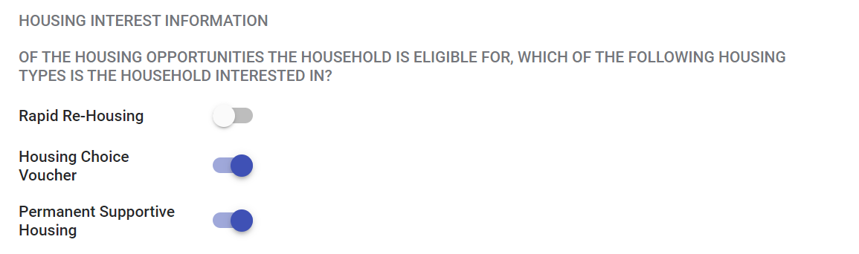
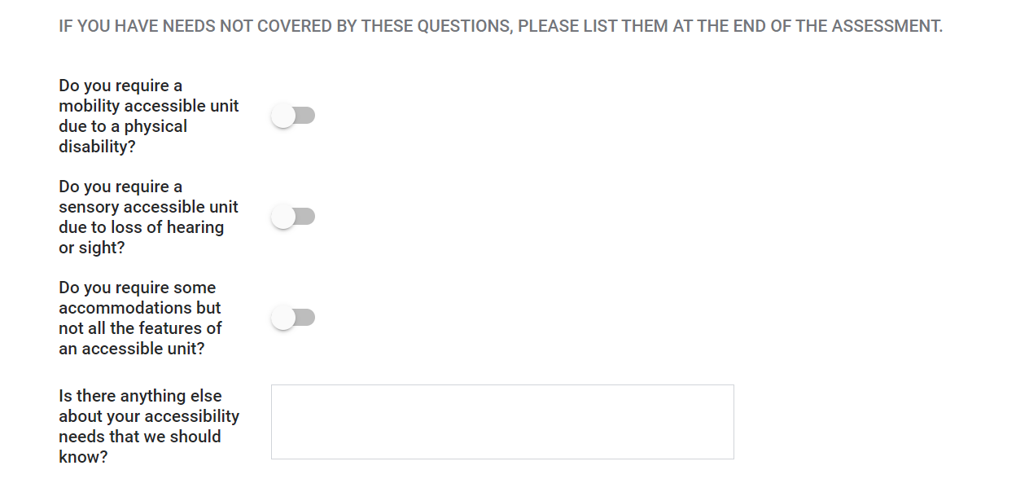
Ices workflow:
Housing planning
What is Housing Planning?
Exploring Housing Intervention Options:
  There are not enough housing opportunities through CES to serve everyone on the community queue.
  Find alternative housing options for participants, such as family reunification, room rentals, low-income housing, assisted living, sober living, and more.
ICES Assessment Questions for Housing Planning:
  Complete the Individual CES Assessment to reflect participant housing interests.
  Answer ADA accommodations questions as needed.

Slide 24
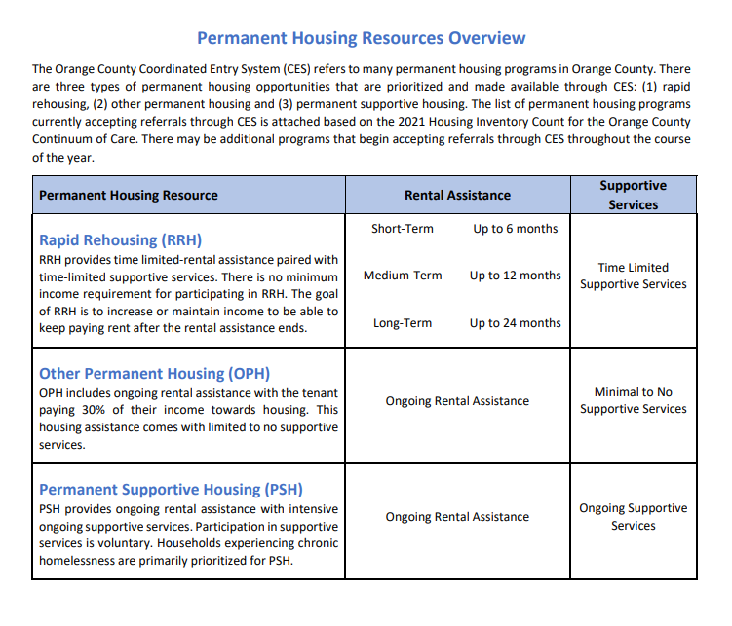
Ices workflow:
Housing planning
What Types of Housing Are Matched Through CES?
Rapid Rehousing (RRH):
  RRH is time-limited rental assistance that can include housing navigation and light supportive services.
  Ideal candidates have income or a clear path to income that can sustain rent for a market-rate unit.
Vouchers:
  Types of vouchers include: HCV, MVP, and CoC Certificates.
  Ideal candidates with low or no income.
  Prioritized for people experiencing chronic homelessness.
  Once a voucher is issued, the tenant must locate a unit and pays 30% of their income toward rent.
Permanent Supportive Housing (PSH):
  Types of PSH include: Scattered-site, single-site, and project-based voucher.
  Prioritized for people experiencing chronic homelessness.
  Participant pays up to 30% of their income toward rent.
  Includes ongoing supportive services and ongoing housing assistance.

Slide 25
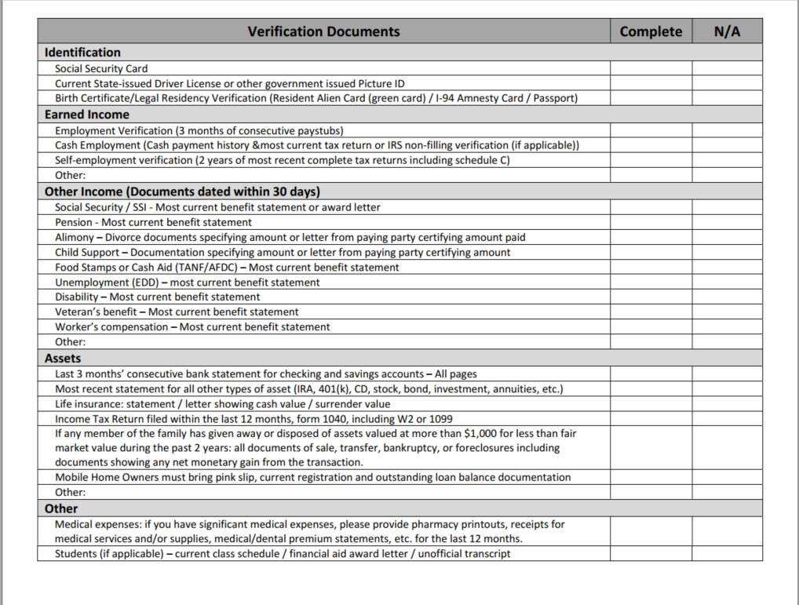
Ices workflow:
Housing planning
[Universal PHA Application]
Gather Vital Documents and Upload to HMIS:
Collection of vital documents:
  ID, Social Security Card/Perm. Resident Card, Birth Cert.
  Income statements from past 90-days.
  Employment earnings statement with TYD earned.
  Transcripts showing PT or FT status.

Slide 26
Ices workflow: Assessment & Referral
ICES Program Entry
Homelessness Documentation
Housing Planning
Assessment & Referral
Maintaining CQ Referrals
Match Confirmation and Housing Navigation
KNOWLEDGE BASED ARTICLE
Click on the link to view step-by-step instructions.

Slide 27
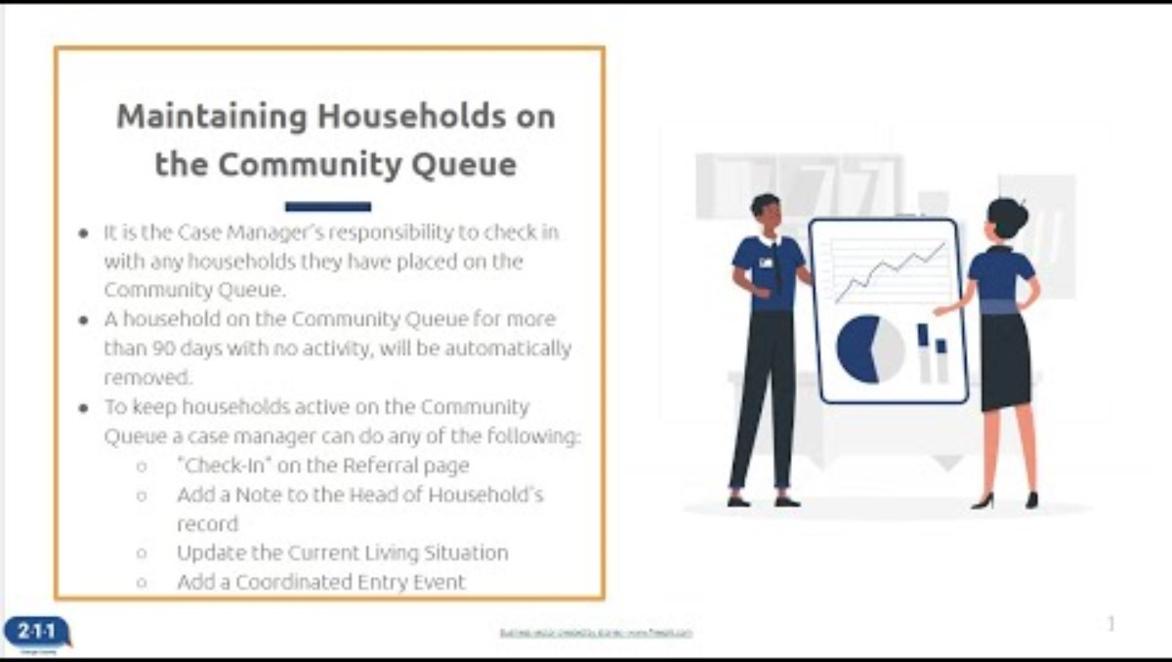
Ices workflow:
Maintaining referrals to the community queue
For participants enrolled in ICES:
Complete a Current Living Situation Assessment every 90-days or less.
The Current Living Situation Assessment can be found under the 'Assessments' tab of the ICES program enrollment.
To learn more about completing a Current Living Situation Assessment click here.
Knowledge Based Article
Click on the link to view step-by-step instructions.

Slide 28
Shelter Bed Reservation System:
Adding households to the Bed reservation Community queue
Steps for Enrollment & Service
1. Ensure Household is Enrolled: Verify enrollment in ICES or FCES project in HMIS.
2. Upload Homelessness Verification: Add the required verification documents to HMIS.
3. Complete Current Living Situation Assessment: Follow guidelines for creating and updating in HMIS.
4. Add “Needs Bed Reservation Assistance” Service: Enter service weekly to keep household active in the queue.
5. Complete Bed Reservation Assessment: Ensure the assessment is completed and refer household to the community queue.
• Criteria for Consideration:
-Active enrollment in ICES or FCES project in HMIS
-Completed Bed Reservation assessment
-Homelessness Verification or Chronically Homeless Verification in HMIS
-"Needs Bed Reservation Assistance" service in HMIS
-Completed Current Living Situation Assessment
• Households are prioritized by vulnerability and must meet project eligibility.
Ongoing Maintenance
• Confirm Need for Assistance: Every Tuesday, check if households still need assistance and add a new service by Wednesday at 9am.
• Automatic Removal: Households with no activity in HMIS for 7 days are automatically removed from the queue.
• Re-Adding to Queue: If removed, add household again via the Assessment screen without needing a new assessment unless client responses change.
Knowledge Based Article
https://ochmis-211oc.happyfox.com/kb/article/356-adding-households-to-the-bed-reservation-community-queue/

Slide 29
Prioritization of the Community Queue​
Chronic Homeless
(No shelter preference)
Literal Homeless, Disabled, Sheltered
Literal Homeless, Disabled, Unsheltered
Literal Homeless, Sheltered
Literal Homeless, Unsheltered
At-Risk or Missing LH Verification
OC CoC Approved CES Prioritization Structure
Priority Group 1:
1. Chronic Homeless Group
Priority Group 2:
1. Literal Homeless Group, Shelter + Disabled
2. Literal Homeless Group, Unsheltered + Disabled
Priority Group 3:
1. Literal Homeless Group, Shelter, not disabled
2. Literal Homeless Group, Unsheltered, not disabled
Priority Group 4:
1. At-Risk or missing homeless verification

Slide 30

Prioritization of the Community Queue​
Data Entry for CES Prioritization Structure
[Participant File Labels]
Chronic Homeless Priority Group Requires
CH Verification + DC Verification
AND
[ICES Program Entry Field]
2. Disabled Priority Status Requires
Disabling Condition Marked ‘YES,’ and the selection of a disability type.
[Shelter Program Enrollment]
3. Sheltered Priority Status Requires
A shelter program enrollment (active) and or a Current Living Situation Assessment.

Slide 31
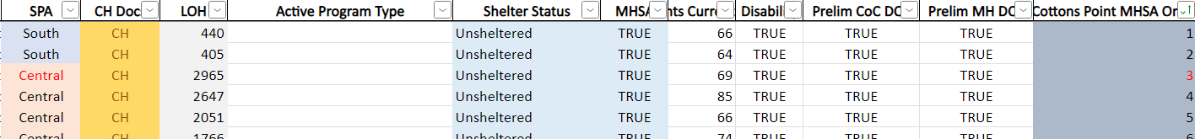
Prioritization of the Community Queue​
Data Entry for CES Prioritization Structure
The Community Queue has programs listed by columns that can be sorted into eligible lists.
A housing program filter only shows participants eligible for the program who are also listed by CES prioritization.
(EX: SOUTH SPA, CH STATUS, MHSA ELIGIBLE)

Slide 32
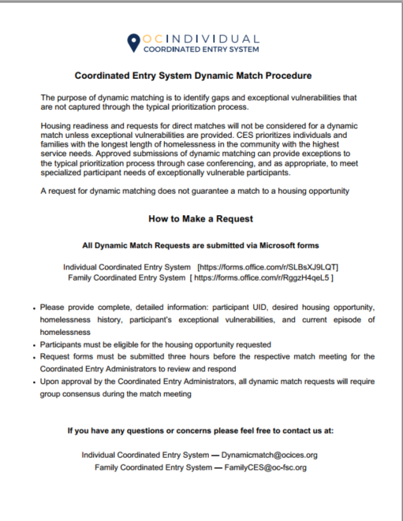
Dynamic prioritization
Dynamic Prioritization Process
Submit requests via the Google Form link prior to the deadline.
CES Teams will review together and approve or deny.
CES SPA Administrator will email the requestor with an approval or denial statement and include next steps.
If approved, the Access Point will attend the match meeting and present their request when it’s time to match the housing opportunity.
The SPA Administrator will open a polling app and collect sufficient votes as are needed to approve or deny.*
If approved, the participant can be matched.
*75% of the attendees must vote YES by meeting poll.

Slide 33
Ices workflow:
ices match meetings
Monitor ICES Communications:
    Ensure you and your staff are included in the CES Directory.
    ICES Match Meeting Information sent out each Monday before 5PM.
    The OC CES password is required to participate and view match materials.
Know Which Match Meetings to Attend
  Review weekly prioritized lists and housing program tabs.
ICES Program Entry
Homelessness Documentation
Housing Planning
Assessment & Referral
CQ Referral
ICES Match Meetings
Match Confirmation and Housing Navigation
ICES Data Standards for Participation
Attend Match Meetings & Accept Matches
  All Individual CES Match Meetings are held virtually via Webex – please create an account.
  CES Access Point must be present to accept any housing matches.
  Know which opportunities fit the participant's goals.
  Provide updates if needed (hospitalizations, exits, etc.).

Slide 34
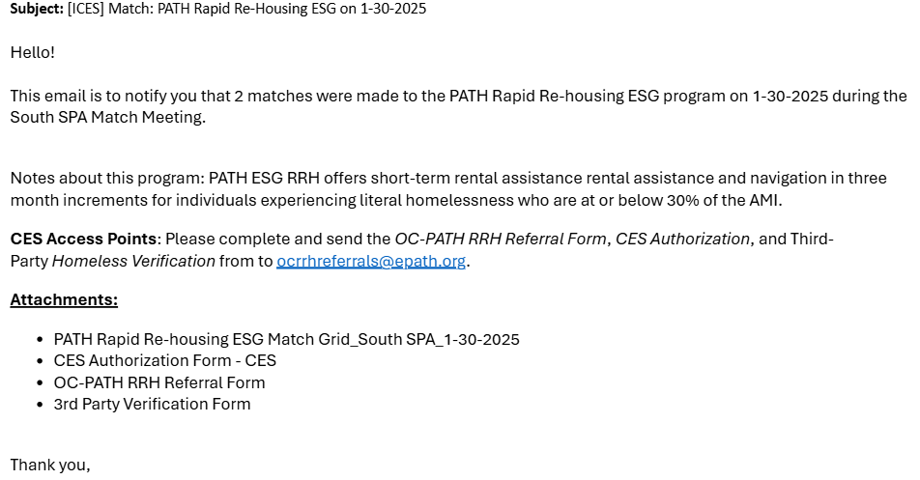
Ices workflow:
Match confirmation & Navigation
[ICES] Match Confirmation Email_Project Name_date
ICES Program Entry
Homelessness Documentation
Housing Planning
Assessment & Referral
CQ Referral
ICES Match Meetings
Match Confirmation and Housing Navigation
ICES Data Standards for Participation
Review the attached program match grid for your participant information prior to informing them of a match.

Slide 35
Housing navigation & Coordination
Lead Navigator
Takes the lead in communicating with Housing Providers
Coordinates with back-up contacts
Back-Up Navigation
Communicates with Lead Navigator to offer support.
May step in as Lead Navigator as needed.
Each match will have a lead housing navigator and may have back-up navigation staff as needed.
ALL contacts on the grid are expected to communicate and support the match by working through the LEAD.
DO NOT ask to be added on a match simply to be informed of the status.

Slide 36
ICES Workflow: ices dATA STANDARDS FOR PARTICIPATION
Must send at least one representative to accept a match.
Add/Remove households from the CQ as needed.
Exit households from their program and ICES as needed.
Update the Care Team field as needed.
Complete a Current Living Situation Assessment every 90-days or less.
Access Points must correct their own data quality issues as needed.
ICES Program Entry
Homelessness Documentation
Housing Planning
Assessment & Referral
CQ Referral
ICES Match Meetings
Match Confirmation and Housing Navigation
ICES Data Standards for Participation

Slide 37

Part 3: ICES Data Errors
Community Queue Errors and Referral Holds
Participants with ICES program enrollment screen or homeless verification documentation errors are marked in RED text on the ICES Community Queue.
Full referral notes can be located under the History tab -> Referral: Coordinated Entry System Community Queue (or hover over the bubble).

Slide 38
Part 3: ICES Data Errors
Community Queue Errors and Referral Holds
"[ices] referral hold: needs more homeless verification."
"[ices] referral hold: enrollment screen error."
Enrollment screen errors affect the prioritization of the community queue.
Examples of enrollment screen errors:
The number of literal homeless episodes in the past three years is more than one when the current episode recorded is greater than three years ago.
Reporting "Data not collected, client doesn't know, client prefers not to answer," for any fields
Uploading a CH document when a participant does not meet criteria for CH status.
Examples of homeless verification missing:
More homeless verification may be needed to support the length of homelessness reported.
For start dates of the current episode stretching back more than three years, provide verification of all months of literal homelessness going back three years to the present month.

Slide 39
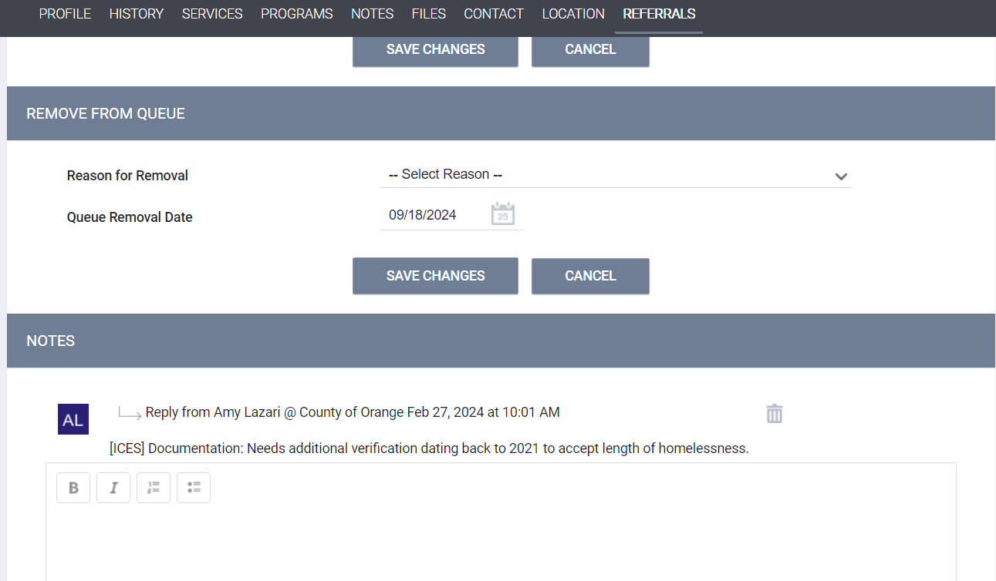
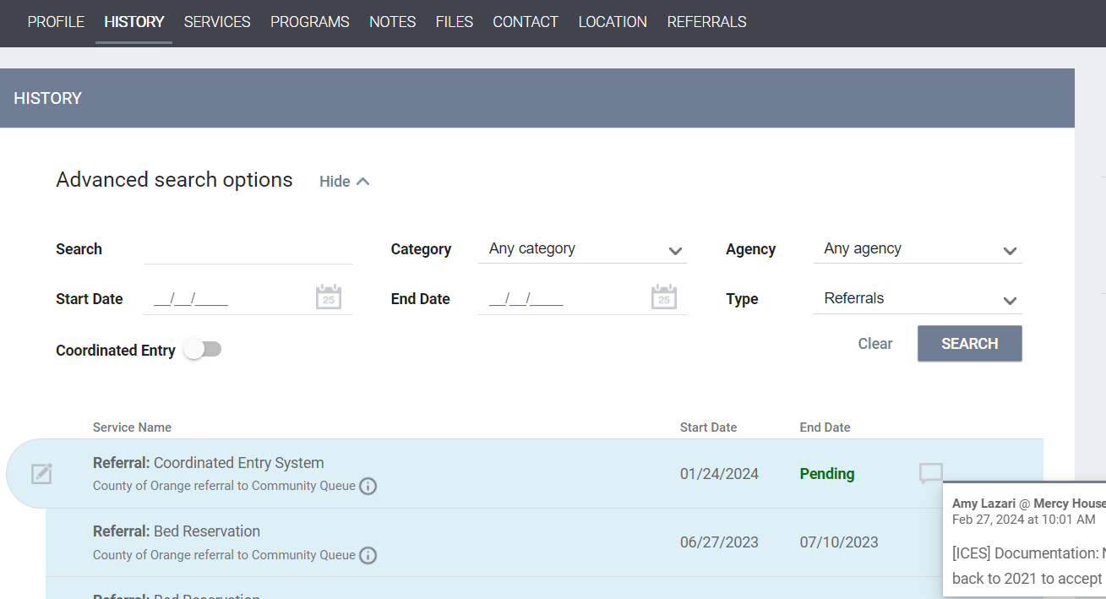
Locating Notes about Errors and Referral Holds
Open the participant's HMIS profile
Go to History, find the Referral: Coordinated Entry System
Click the 'edit' button
Participants with a referral hold will be marked in red text on the CQ and ineligible for match until the error is fixed.
Can hover the bubble to view referral notes.
Or click on the edit button to view note.

Slide 40

PART 4: Sample scenario
Shiloh is a navigation staff with an Individual Access Point agency in Orange County.
After meeting with a new participant, Shiloh takes the following steps:
Logs into HMIS and selects the County of Orange agency view.
Searches the participant by date of birth or last four of their SSN.
Confirms they already have a profile and verifies their identifying information.
Reviews the participant’s program history tab.
…The participant is not enrolled in the Individual CES program.

Slide 41
PART 4: Sample scenario
Shiloh begins to complete the ICES enrollment.
Shiloh knows that the field, “approximate date the current episode of homelessness began,’ is important for the participant’s prioritization on the Community Queue.
During their meeting, Shiloh asked the following questions:
What month/year did you first become homeless?
In the past three years, have you ever stayed in a place that wasn’t the street or a shelter, such as a friend’s house or a motel?
If they say YES, Shiloh also asks…
  When did that happen and for how many nights?
  Did you pay for your stay?

Slide 42
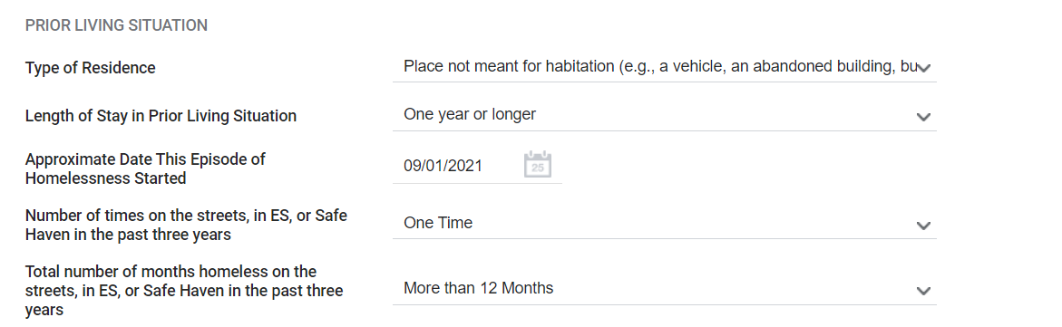
PART 4: Sample scenario
The participant then shared the following homeless history:
“I have been homeless since September of 2021, when I lost my job and my mom, who I was living with. I have tried to stay off the street and stay with friends when I can but never for more than two or three nights. I have not been able to stay in motel more than a night or two either. I have not stayed anywhere but the street for the past few months.”

Slide 43

PART 4: Sample scenario
Shiloh also collects information from the participant about any disabilities, income sources, and insurance…
During their meeting, the participant also expressed some mobility concerns and believes they are permanently disabled – they also want to get a walker.
Shiloh marks yes for Disabling Condition and for Physical Disability.
He assists the participant with making an appointment at a local clinic to be evaluated for their mobility concerns and to have the clinician complete a disability verification.

Slide 44
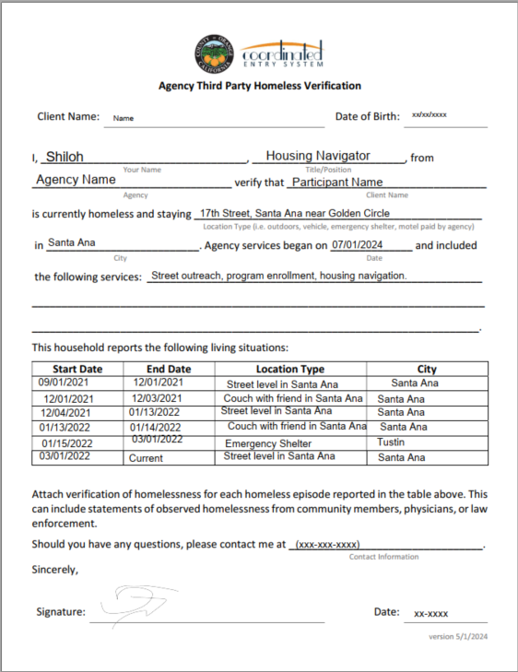
PART 4: Sample scenario
Shiloh Uploads a Literal Homeless Verification
Using the Agency Third-Party Verification form, Shiloh records a timeline of the participant’s self-reported homeless history.
Since Shiloh enrolled the participant in July of 2024 and it is now September 2024, he can only verify for those three months.
Shiloh tells the participant to reach out to anyone who can confirm their history of homelessness for the past 3 years.
The couch surfing episodes were less than seven nights, so no breaks in homelessness occurred.***

Slide 45
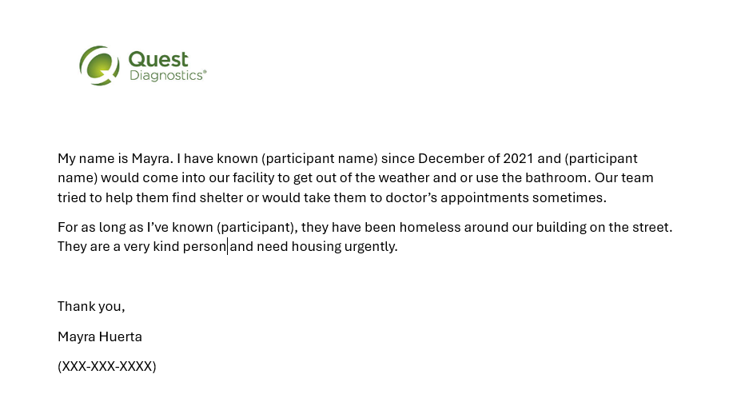

PART 4: Sample scenario
The participant contacts a staff member at Quest Diagnostics and asks them to write a letter verifying their history of homelessness. The staff member emails Shiloh a verification. It looks complete, but Shiloh is concerned that the letter does not give enough detail about the history of observed homelessness.
Shiloh decides to call the staff member to gather more information about their encounters with the participant.
Shiloh then writes a letter of attestation to confirm the information from the Quest staff member.

Slide 46
PART 4: Sample scenario
Shiloh completes the CES Assessments:
Now that at least one (or more) homeless verification has been added to the participant’s HMIS file, Shiloh can refer the participant to the ICES Community Queue.
But first…
Completes a Current Living Situation Assessment.
Adds location and contact information to the profile.
Discusses housing program options with the participant.
Discusses any potential ADA needs.
Then…
Completes the ICES Individual CES Assessment

Slide 47

PART 4: Sample scenario
Shiloh attends the CES Match Meetings & Virtual Office Hours:
Shiloh notes that the participant’s name appears in the Central SPA and wonders why this is.
  Shiloh attends ICES Virtual Office Hours and learns the reason: He put Santa Ana as the participant’s city they slept in on the night before enrollment in the program.
  Shiloh also learns that if the participant wants to be housed in Santa Ana, it may be beneficial to add documents that show a live, work, or school history.

Slide 48
PART 4: Sample scenarios
Shiloh continues to upload additional documents
Universal Disabling Condition Verification.
CA ID, Social Security Card and Birth Certificate.
SSDI annual award letter.
Car registration and W2s with their Santa Ana address.
Completed Santa Ana Residency Verification.

Slide 49
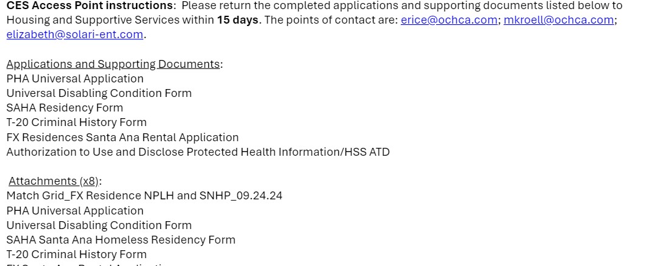
PART 4: Sample scenarios
Shiloh Accepts a Housing Match
Shiloh accepts a match for his client to a PSH project.
Receives the match confirmation email and confirms the grid information.
Informs participant of match and confirms interest.
Works with the participant to gather and submit all requested documents and application materials to the housing provider before the deadline.

Slide 50

PART 4: Sample scenarios
Shiloh Completes Housing Navigation
The participant is approved by property management and the Santa Ana Housing Authority and Shiloh accompanies the participant to the lease signing.

Slide 51
Resources
For more information on CES from the Office of Care Coordination please click here
For a current list of CES documents, please click here.
For CES Policy and Procedures, please click here
For information on the CES Shelter Bed Reservation System, please click here
For the ICES team website and resources, please click here
For Knowledge Base Articles regarding HMIS via 211, please click here

Slide 52
Q&A
THANK YOU!
For more information, come to virtual office hours or contact your SPA administrator.

