Slide 1
MHSA Certification Elise Rice, LMFT Service Chief II OC Health Care Agency Behavioral Health Services Adult & Older Adult Housing and Supportive Services

Slide 2
Agenda
Mental Health Services Act (MHSA)
Eligibility vs Certification
How to make a request
Assessments
Prioritization in CES
MHSA unit match
Questions

Slide 3
MHSA Overview
Mental Health Services Act (MHSA) Prop 63
MHSA Permanent Supportive Housing (PSH) with contracted supportive services onsite
HCA Housing and Supportive Services (HSS) oversees a total of 670 MHSA units at 38 properties. Additional 10 properties in 2025-2027 Pipeline.
HSS is in partnership with developers from early funding stages through full property operation.
HSS staff play a key role in MHSA lease up/move in process.
HSS Behavioral Health Clinicians assigned to each property for on-site support and collaboration.

Slide 4
Eligibility versus Certification
MHSA Eligibility
ICES enrollment has Disabling Condition Mental Health, Long Term
Disabling Condition Verification form signed by Licensed professional, SMI or PTSD
MHSA Certification
Housing and Supportive services (HSS) verifies that applicant meets MHSA criteria and completes the MHSA certification
Additional documentation may be requested to support the SMI diagnosis

Slide 5
How to Make a Request
Email HSS@OCHCA.com, cc erice@ochca.com
Subject Line: MHSA Certification Requestion
Body of email
Applicant’s name and HMIS Unique Identifier
Name of Mental Health Provider (example: Telecare)
Attach signed Release of Information Forms ( Provider to HSS/HSS to Provider)
Attach signed Disabling Condition Verification Form
HSS will review the documents and may request further documentation such as a Treatment Plan with diagnosis from the Mental Health Provider

Slide 6
MHSA Certification in HMIS
MHSA Certification in HMIS
HMIS Profile
Assessments
[OC Custom] CES Housing Eligibility
MHSA Certification

Slide 7
MHSA Assessments
In partnership with CES, Housing and Supportive Services is launching a new process that will help identify MHSA eligible applicants that may be interesting in scheduling an MHSA assessments
Housing and Supportive Services will send out an email to the Care Team to inquire if the applicant is interested in scheduling an assessment

Slide 8
MHSA Prioritization in CES
Example
MHSA Certified, CH, by LOH, North SPA, city ties
MHSA Eligible, CH, by LOH, North SPA, city ties
MHSA Certified, CH, by LOH, County-Wide, city ties
MHSA Eligible, CH, by LOH, County-Wide, city ties
MHSA Certified, LH with disability, by LOH, County-Wide, city ties
MHSA Eligible, LH with disability, by LOH, County-Wide, city ties

Slide 9
MHSA UNIT MATCH
MHSA assessments are also available after the match is made if applicants need to complete the MHSA Certification
HSS lease up team will send the MHSA certification and the Disabling Condition Verification Form to property management and housing authority

Slide 10
Questions
Thank you for joining!

Slide 11
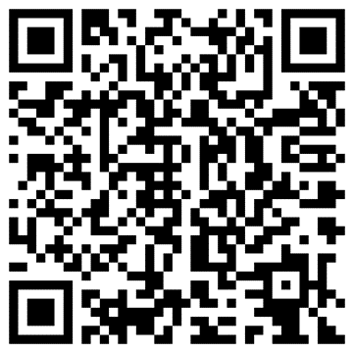
Stay Connected
OC Health Care Agency
@ochealthinfo
www.ochealthinfo.com
@ochealth
@oc_hca
@ochealth

